Slide 1
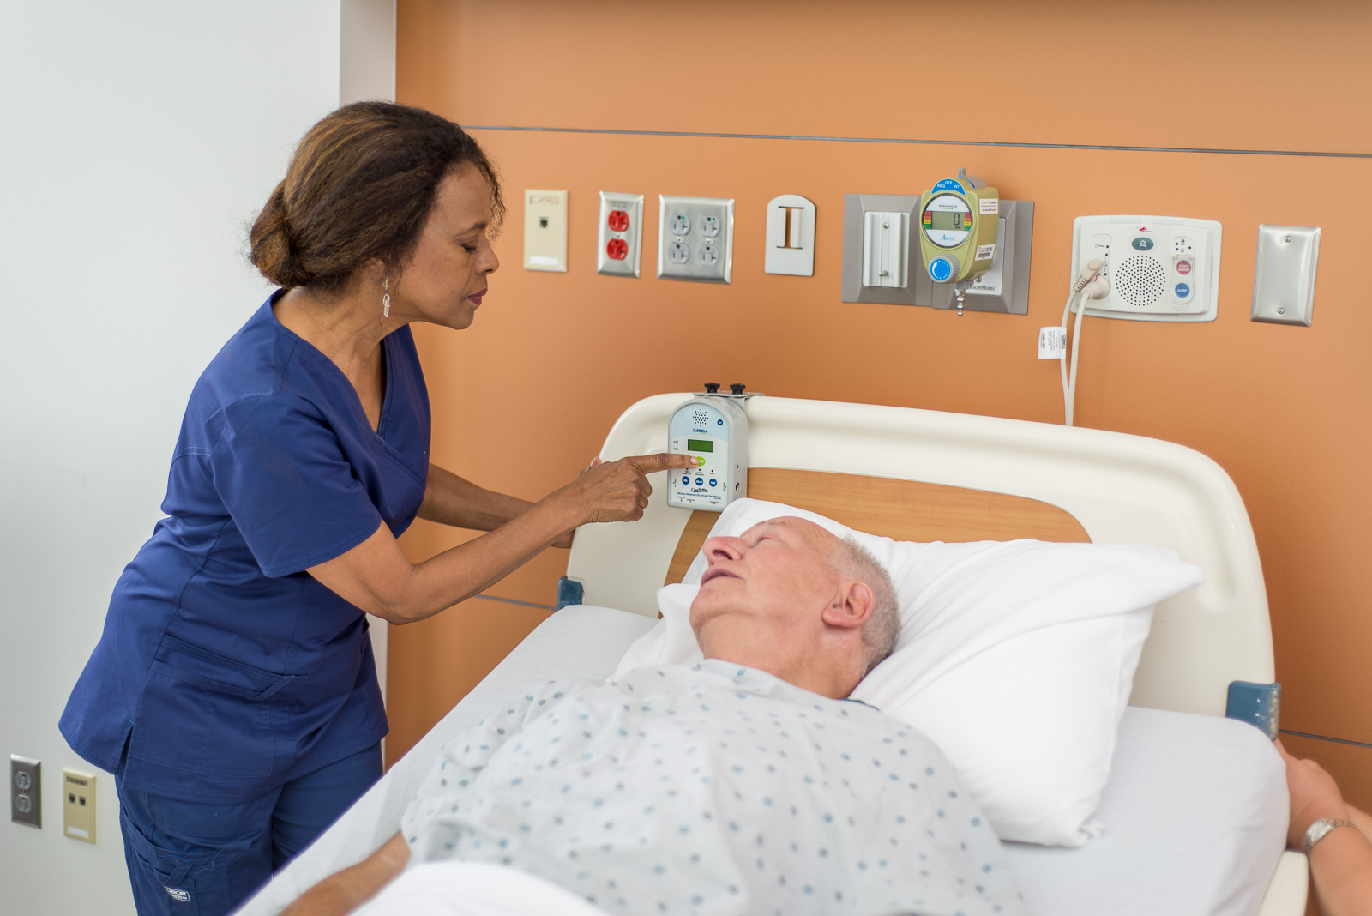


Fall Management
New Product Release
Notes:
1
DY

Slide 2
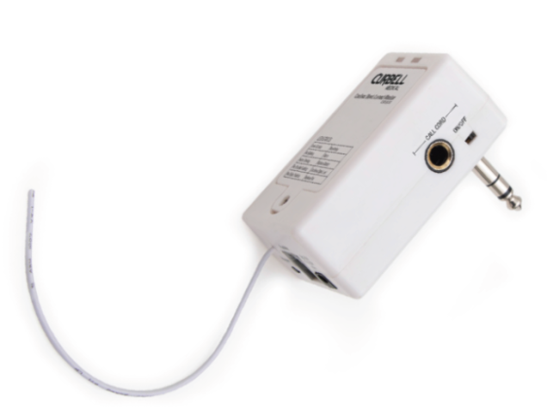
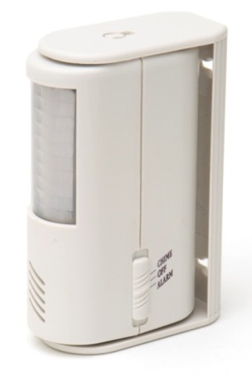
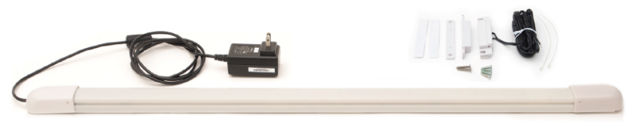
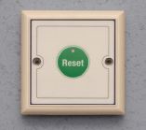

Agenda
PRODUCT Training
  Direct Connect Cordless Monitor
  CSM-BC500
  Motion Sensor
  CS-MS100
  Door Wander System
  WM-KIT1

Slide 3
Cordless Direct Connect Monitor (CSM-BC500)
CSM-BC500 Direct Connect Monitor

Slide 4
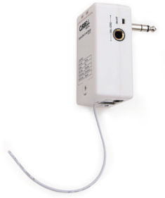
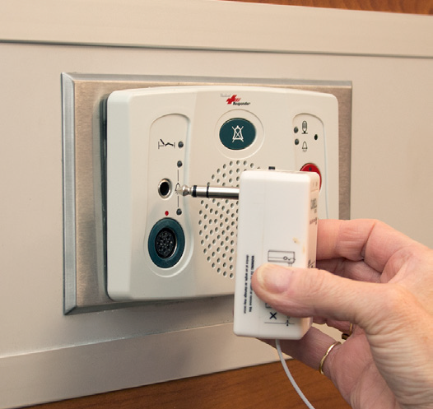
Cordless Direct Connect Monitor (CSM-BC500)
CSM-BC500 Direct Connect Monitor
Simple, low cost cordless bed and chair monitor
  Alternative solution to BC400 or BC201
Eliminates cord tripping hazards and cord damage when used with cordless sensors.
Battery and pad replacement notification
Silent alarm, reduce alarm fatigue.
  No audible alarm from monitor
Plugs directly into nurse call.
  Activates an audible alarm through nurse call
Notes:
Handout DFU and Product info sheet

Slide 5
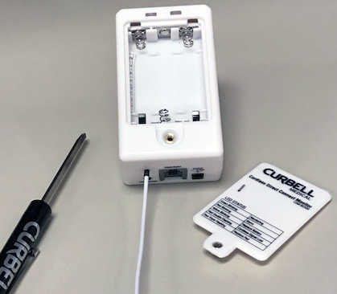
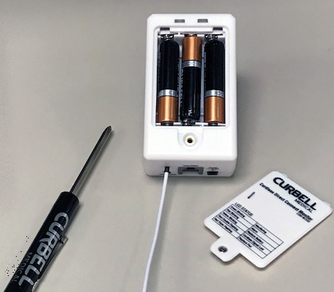
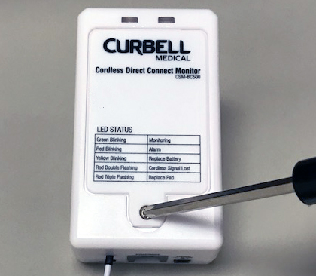
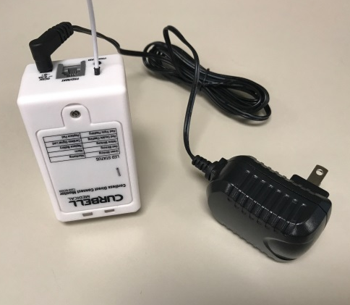
Cordless Direct Connect Monitor (CSM-BC500)
SETTING UP MONITOR
Open the battery compartment:
Install Three “AAA” Batteries
Close cover and secure screw
Optional: Add AC Adaptor (5v/500mA) to extend Battery Life

Slide 6
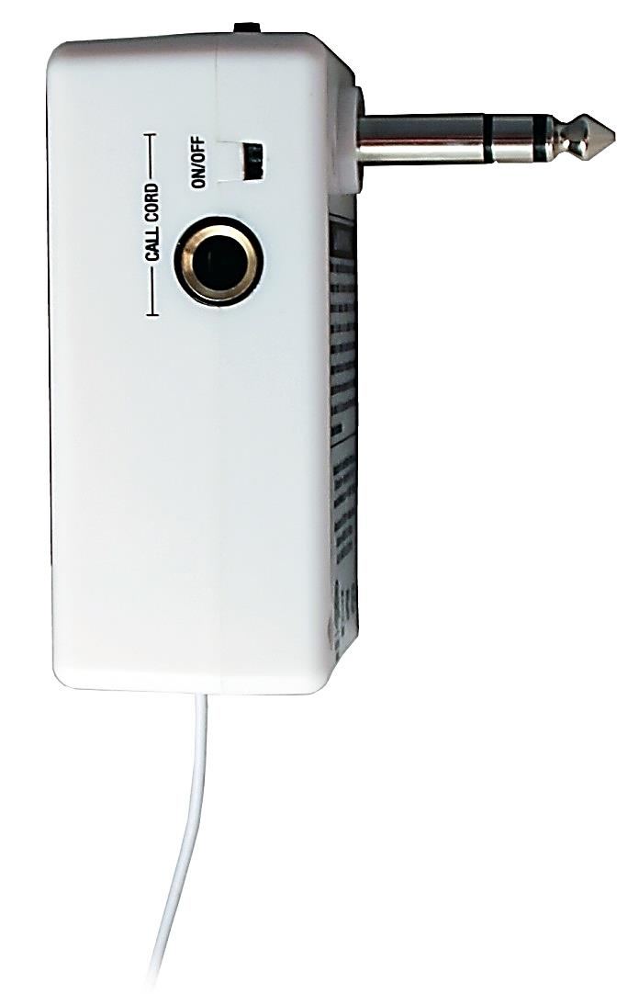
Cordless Direct Connect Monitor (CSM-BC500)
SETTING UP MONITOR
Call Cord switch is to be in the “OFF” position if not using a call cord and before initially inserting the nurse call plug or cable into the patient station
If using with the Call Cord, switch to “ON” after connected to the patient station and inserting the Call Cord

Slide 7
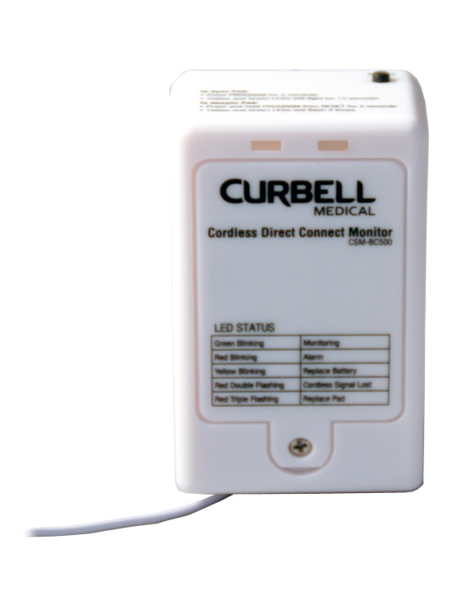
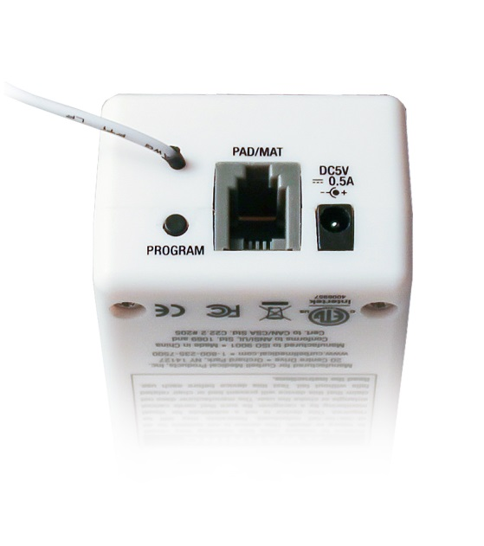
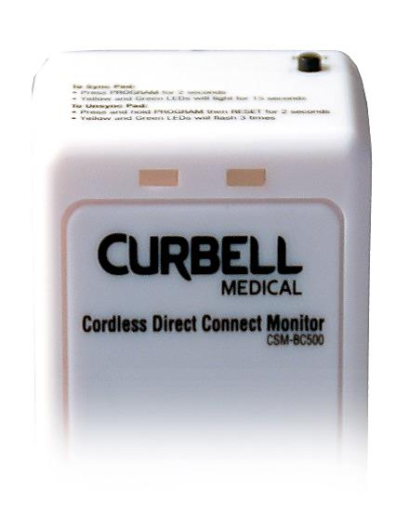
Cordless Direct Connect Monitor (CSM-BC500)
SETTING UP MONITOR
The monitor is factory set to be non-latching (compatible with industry-standard latching nurse call systems).
To change the monitor to latching, press and hold the program button for approximately 15 seconds until both LEDs flash simultaneously three times.
Notes:
The monitor is intended only to be connected to a nurse call system, so that when the alarm is activated, a call will be placed to the nurse’s station. The monitor is compatible with a normally open nurse call system only, using a 1⁄4" mono nurse call jack.

Slide 8
Cordless Direct Connect Monitor (CSM-BC500)
SETTING UP MONITOR
To change back from latching to non-latching, press and hold the program button for approximately 15 seconds until both LEDs flash simultaneously two times.

Slide 9
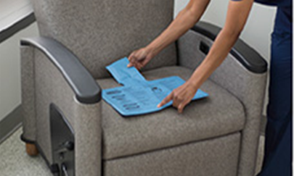
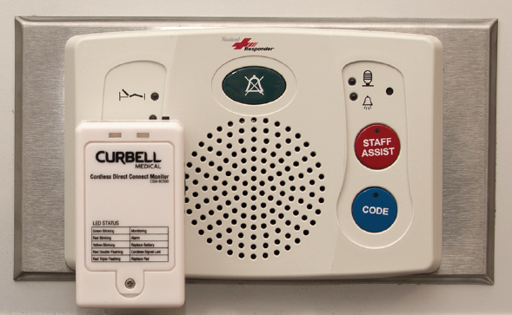


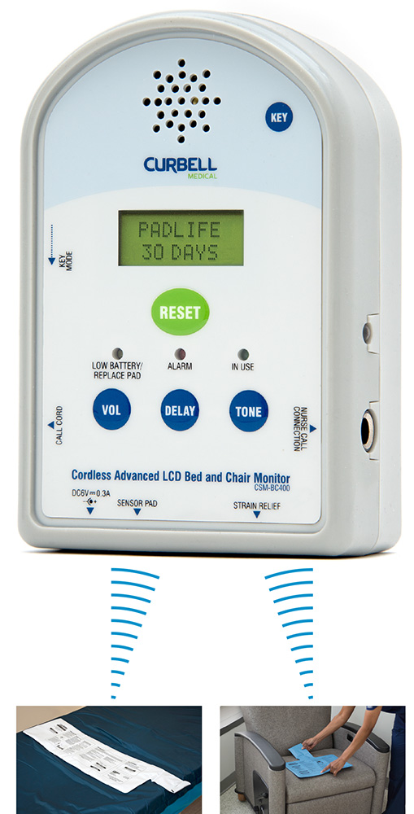

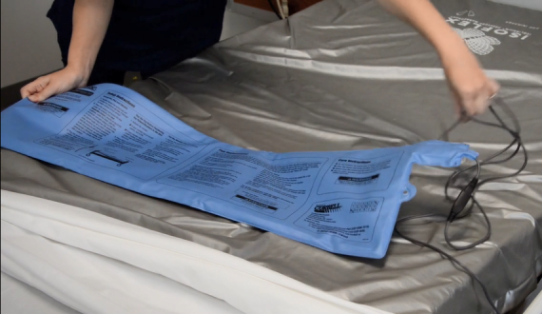
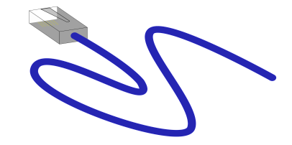
Cordless Direct Connect Monitor (CSM-BC500)
USING MULTIPLE SENSORS
Compatible with up to THREE Sensor Pads
  2 WIRELESS sensor pads
    Up to 30 ft. cordless range
  1 CORDED sensor pads

Slide 10
Cordless Direct Connect Monitor (CSM-BC500)
SYNCHRONIZING WITH CORDLESS SENSOR
Press and hold the black programming button located on the bottom of the monitor for approximately 3 seconds
Both yellow and green LED’s will then light for 15 seconds

Slide 11

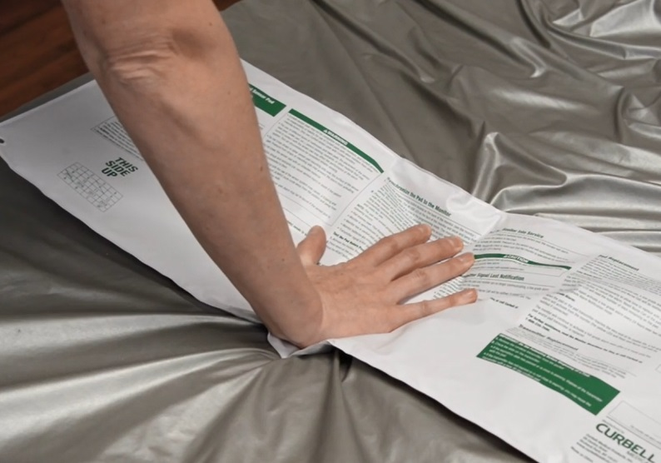
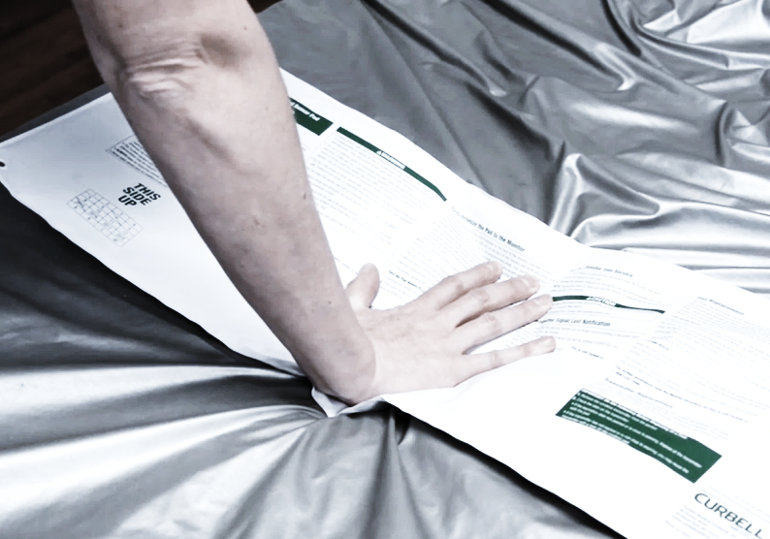
Cordless Direct Connect Monitor (CSM-BC500)
SYNCHRONIZING WITH CORDLESS SENSOR
Within 10 seconds, place pressure on the sensor pad and then release.
The yellow LED will then blink once, confirming the monitor and pad are now synchronized and ready for use.

Slide 12
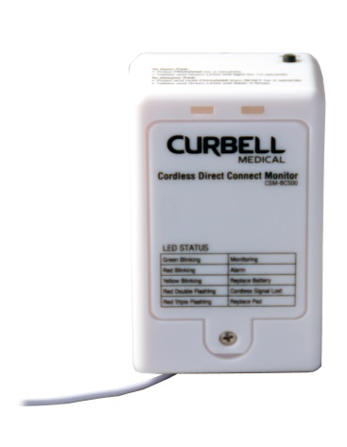

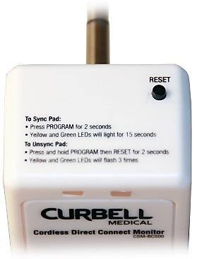

Cordless Direct Connect Monitor (CSM-BC500)
UNSYNCHRONIZING WITH CORDLESS SENSOR
Press and hold the PROGRAM button first, then press and hold the RESET button at the same time, for two seconds
The yellow and green LED’s will simultaneously flash three times indicating that the pad(s) has been unsynchronized

Slide 13
Cordless Direct Connect Monitor (CSM-BC500)
CORDED SENSOR USE
Plug the sensor cord into the monitor’s sensor jack
Both LEDs flash 3 times simultaneously

Slide 14
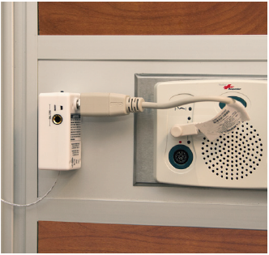
Cordless Direct Connect Monitor (CSM-BC500)
INSERT INTO patient station
Connects directly into nurse call
Option to side mount with nurse call cord connection
  BC500 wall-mount bracket is available and sold separately
  Adaptor sold separately
  Velcro attachment is not recommended – If call cord used, risk of detaching

Slide 15
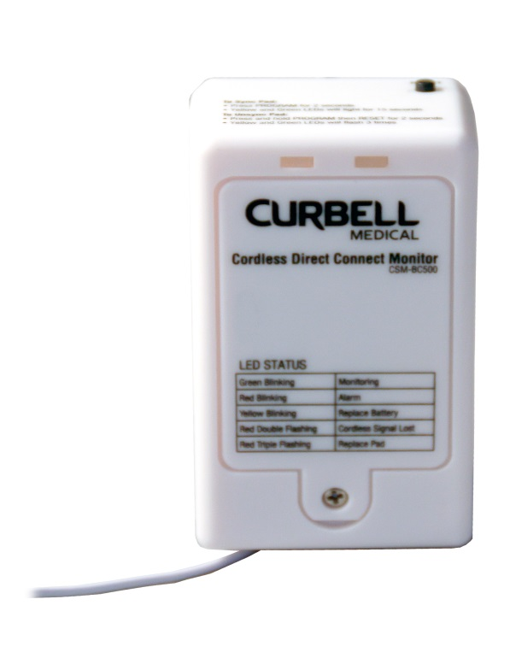
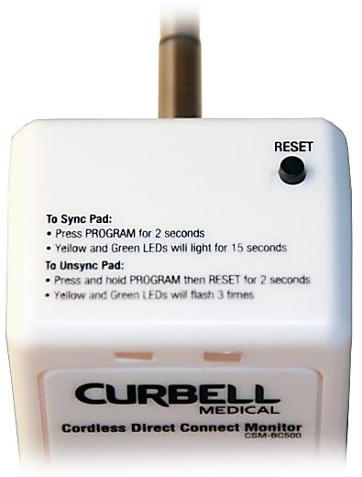
Cordless Direct Connect Monitor (CSM-BC500)
USING THE MONITOR:
The RESET button provides the following two functions
  Cancels the alarm
  Places the monitor into a pause mode

Slide 16

Cordless Direct Connect Monitor (CSM-BC500)
USING THE MONITOR:
Testing the alarm
  When pressure is placed back on the pad, the GREEN LED will blink two times and then continuously every three seconds indicating the pad is in use

Slide 17


Cordless Direct Connect Monitor (CSM-BC500)
USING THE MONITOR:
Testing the alarm
  Remove pressure from the pad to activate the alarm
  The Red LED will then blink (for 10 seconds)
  An audible alarm will only occur from the Nurse Call System in the room and patient station or just at the patient station (depending on nurse call station)

Slide 18
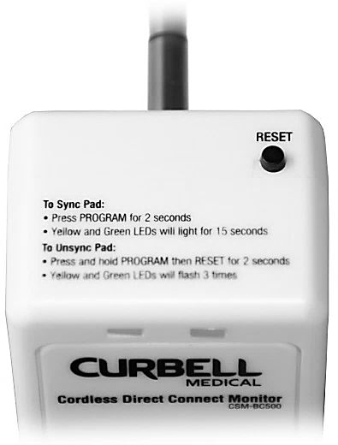
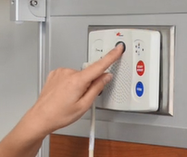
Cordless Direct Connect Monitor (CSM-BC500)
USING THE MONITOR:
Testing the alarm
  To cancel the alarm, press the monitors RESET button and CANCEL the nurse call alarm at the patient station

Slide 19


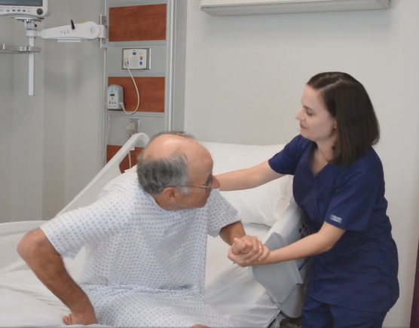
Cordless Direct Connect Monitor (CSM-BC500)
USING THE MONITOR:
Using the PAUSE MODE
  While patient is on the pad, press the RESET button on the top of the monitor
  The patient may be removed from pad within 30 seconds without activating an alarm
  The monitor will then stay in the pause mode for the full 30 seconds and reactivate once the patient is put back on the pad
1
2
3

Slide 20
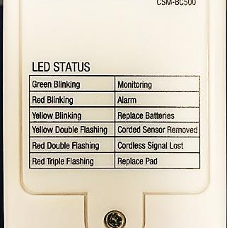
LED Indicators:
Direct Connect Cordless Monitor (CSM-BC500)
Cordless Direct Connect Monitor (CSM-BC500)
LED STATUS:
LED status located on the battery compartment side

Slide 21
LED Indicators:
Direct Connect Cordless Monitor (CSM-BC500)
Cordless Direct Connect Monitor (CSM-BC500)
LED STATUS:
Green LED is continuously blinking
Monitoring

Slide 22
Cordless Direct Connect Monitor (CSM-BC500)
Direct Connect Cordless Monitor (CSM-BC500)
LED STATUS:
Red LED is continuously blinking
Alarming

Slide 23
LED Indicators:
Direct Connect Cordless Monitor (CSM-BC500)
Cordless Direct Connect Monitor (CSM-BC500)
LED STATUS:
Yellow LED is continuously blinking
Low Battery

Slide 24
Cordless Direct Connect Monitor (CSM-BC500)
Direct Connect Cordless Monitor (CSM-BC500)
LED STATUS:
Yellow LED flashes twice continuously
1…
2…
Corded Pad Disconnected

Slide 25
Cordless Direct Connect Monitor (CSM-BC500)
Direct Connect Cordless Monitor (CSM-BC500)
LED STATUS:
Red LED flashes twice continuously
1…
2…
Cordless Pad Signal Lost

Slide 26
LED Indicators:
Direct Connect Cordless Monitor (CSM-BC500)
Cordless Direct Connect Monitor (CSM-BC500)
LED STATUS:
Red LED flashes three times continuously
1…
2…
3
Replace Curbell Pad

Slide 27

Cordless Direct Connect Monitor (CSM-BC500)
CSM-BC500 SPECS
Dimensions 3"H x 1.75"W x 1.75"D
Frequency: UHF - 433.92MHz+/-0.5
Battery operated
  Three AAA (included)
    ~3-4 months lifespan
  Optional AC Adaptor (sold separately)
    Length 72” (182cm)
    Extends battery life
      ~1 year

Slide 28
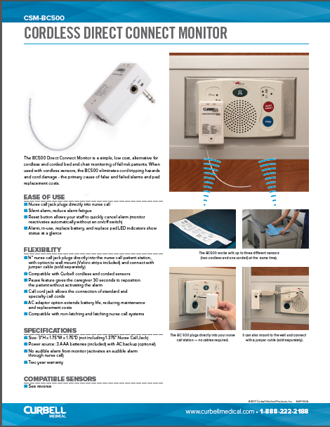


Cordless Direct Connect Monitor (CSM-BC500)
ADDITIONAL INFO:
Compatible with non-latching and latching nurse call systems
ETL, FCC
Two year warranty
MSRP $139.95
  CSM-BC201 $124.95
  CSM-BC400 $208.95
CSM-BC500 Information Sheet

Slide 29

Cordless Direct Connect Monitor (CSM-BC500)
Suggested Applications
Easy to use, low cost cordless monitor option when compared to BC400
Where not having an in-room audible alarm is a concern
  Noise Reduction
  Patient Satisfaction
Where 3 sensors may be needed
  2 Cordless, 1 Corded
Need a latching monitor for system compatibility
  Field Programmable

Slide 30

Question/Answer

Slide 31
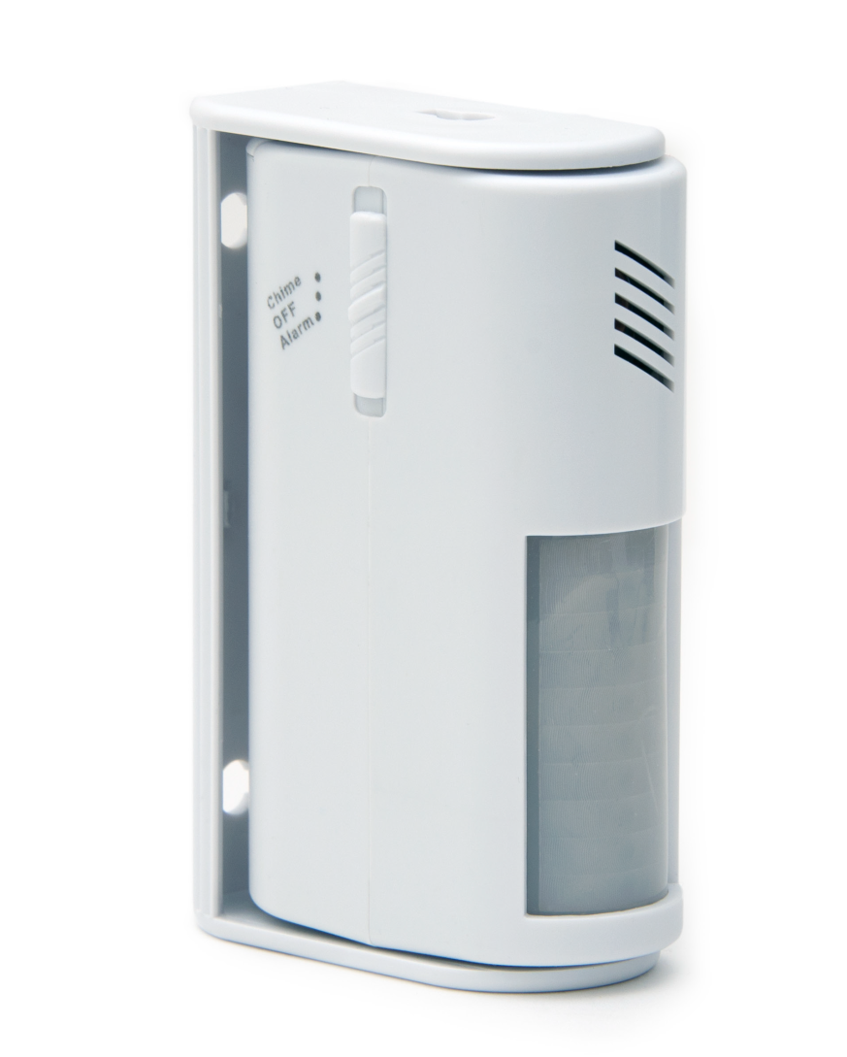
Motion Sensor (CS-MS100)
CS-MS100 Motion Sensor

Slide 32
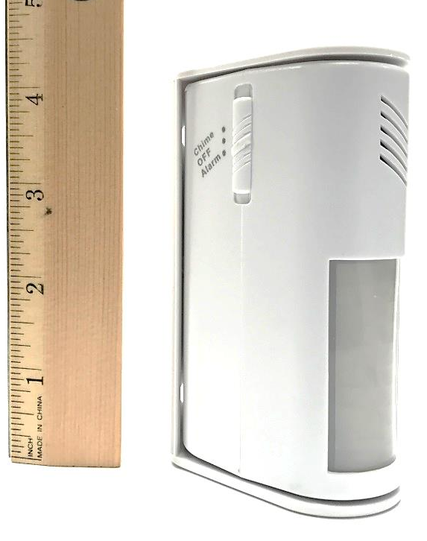
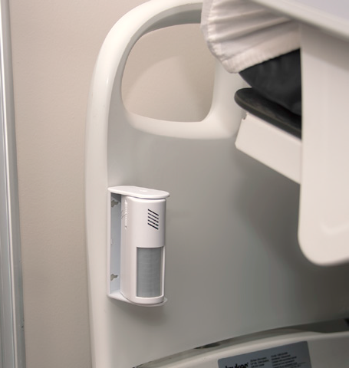
Motion Sensor (CS-MS100)
CS-MS100 Motion Sensor
Simple, low cost motion detection solution
  Ideal alternative for low risk patient monitoring
Small, compact design that can mount anywhere
  Can be installed horizontally or vertically on most surfaces
Infrared motion detection works in light and dark conditions
  Great for detecting patients’ movement at nighttime – reducing fall risk
Notes:
Handout DFU and Product info sheet

Slide 33


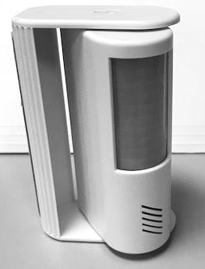

Motion Sensor (CS-MS100)
CS-MS100 Features
Infrared motion detection
60º detection angle
180º adjustable mounting bracket
Built-in Speaker
Notes:
Handout DFU and Product info sheet

Slide 34
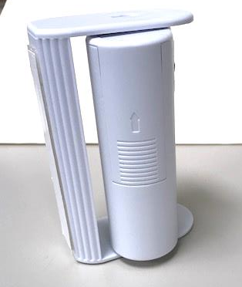
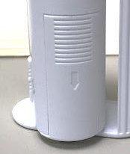
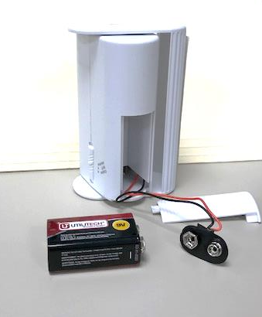
Motion Sensor (CS-MS100)
SETTING UP THE SENSOR ALARM
Rotate the sensor in the bracket to access the battery door
Slide open the battery door cover located on the back
Connect the 9-volt battery and wait 60 seconds before use
Replace the battery door cover

Slide 35
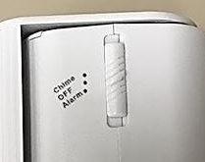
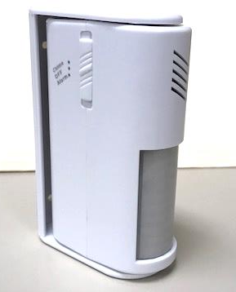
Motion Sensor (CS-MS100)
SETTING UP THE SENSOR ALARM
SENSOR MODES
  Alarm Mode
    When motion is detected, audible alarm for 15 seconds and then stops
    Remains silent until it detects motion again
  Chime Mode
    When motion is detected, monitor will chime twice and then stops
    Remains silent until it detects motion again

Slide 36
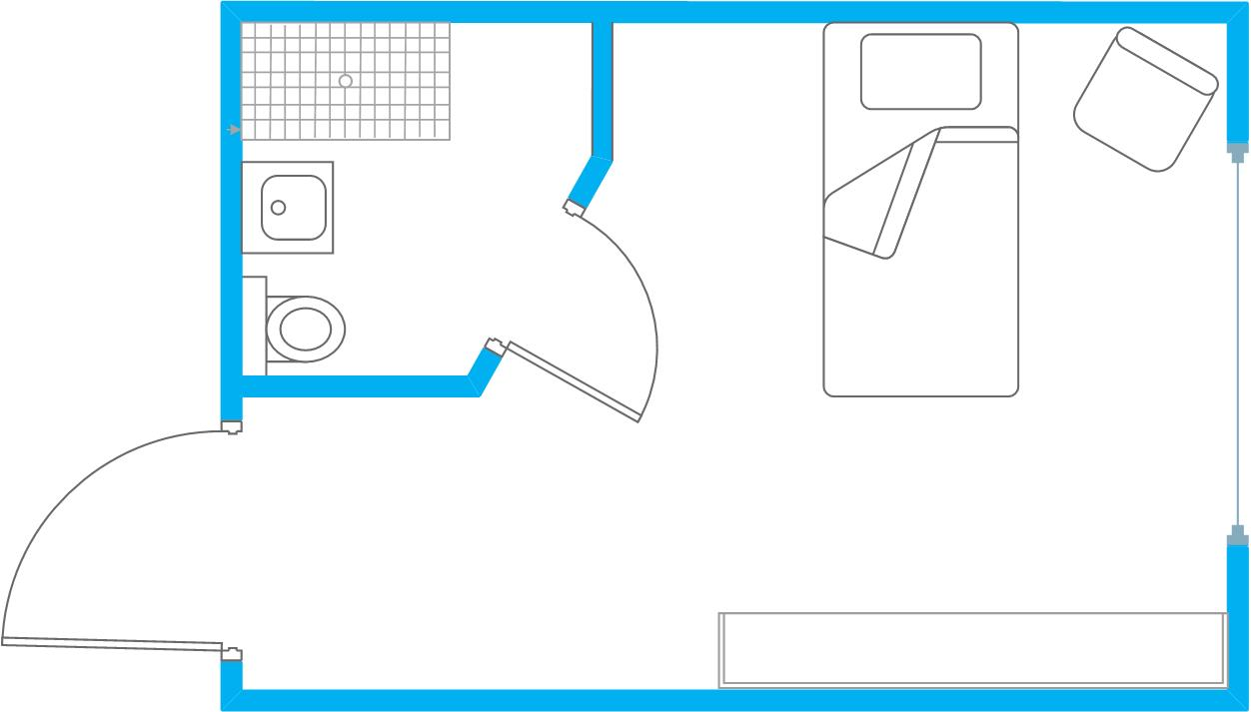

Motion Sensor (CS-MS100)
INSTALLING THE SENSOR ALARM
Determine the desired area to be monitored
  Stand Alone - Local alarm only, does not integrate with Nurse Call
Can be installed horizontally or vertical

Slide 37

Motion Sensor (CS-MS100)
CS-MS100 Specs
Compact Size
  4" H x 2.5” W x 1.25”
Wall-mounted bracket
  Screws and foam tape (included)
Battery operated
  One 9-volt battery (included)

Slide 38
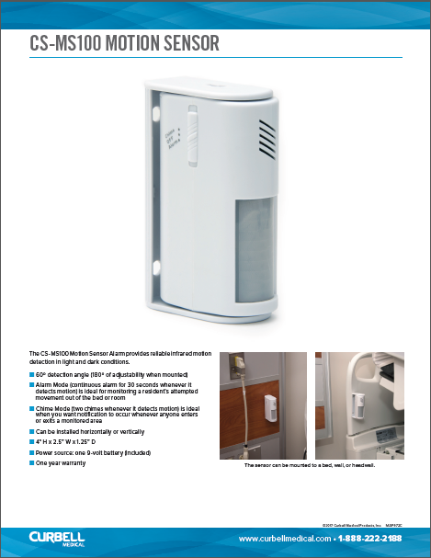
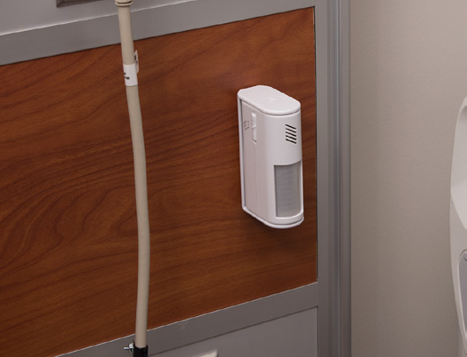
Motion Sensor (CS-MS100)
ADDITIONAL INFO:
One year warranty
MSRP $37.90
CS-MS100 Information Sheet

Slide 39

Motion Sensor Applications
Suggested Applications
Simple low cost monitoring alternative to bed, chair and floor sensor pad technology
Ideal application when nurse call connectivity is not needed
Chime mode at room entrances to help with wandering residents and privacy concerns

Slide 40
Question/Answer

Slide 41
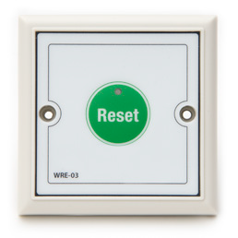
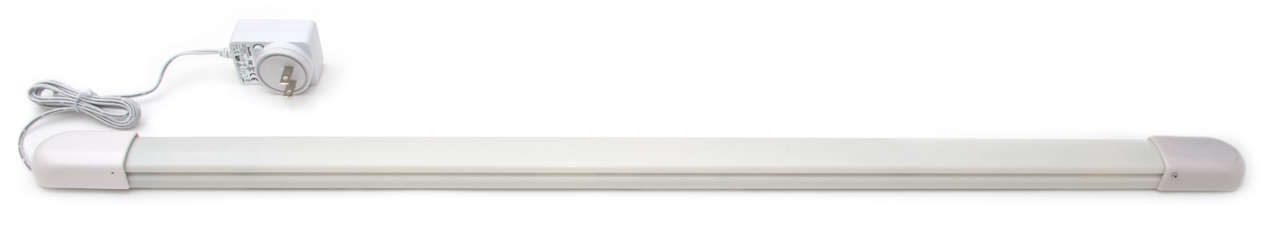

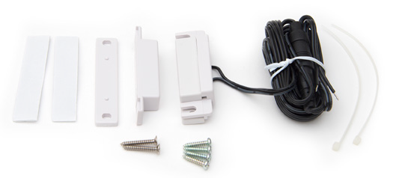
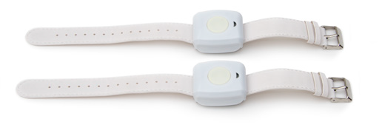
Door Wander System (WM-KIT1)
WM-KIT1 Wander Management System

Slide 42
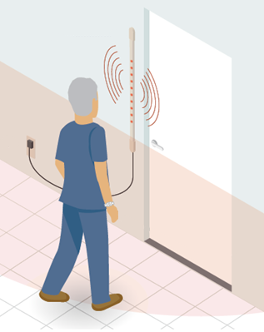
Door Wander System (WM-KIT1)
WM-KIT1 Wander Management System
Simple solution to help prevent patients from wandering off the premises
Low cost alternative to more complex, very expensive wander management systems
Flexibility of the system allows you to customize to your facility’s needs
  Monitoring many patients at one time in a common area
  Monitoring one patient in a single room
Notes:
Handout DFU and Product info sheet

Slide 43
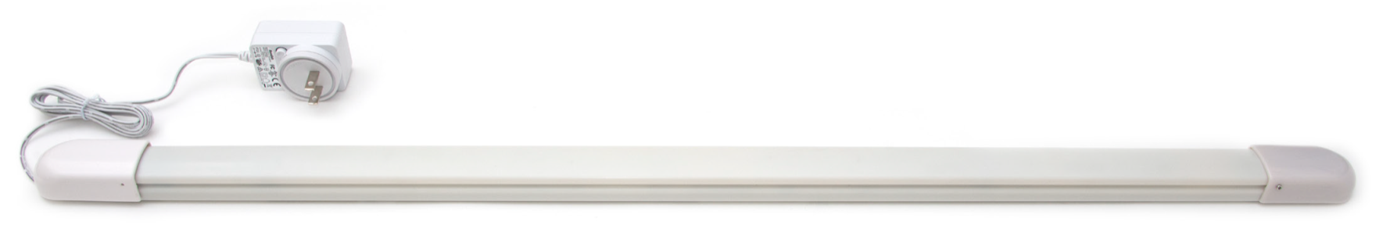
Door Wander System (WM-KIT1)
WM-KIT1 Features and Benefits
Wristband wearer sets off alarm when in range of Door Strip Sensor
Alarm cancelled by pressing Reset Button at wall
Stand alone
  Local alarm only, does not integrate with Nurse Call
Included magnetic door contact can be used so that the alarm sounds when door is opened
Notes:
AC Adapter cord is 54” (137cm)
Handout DFU and Product info sheet

Slide 44



Door Wander System (WM-KIT1)
WM-KIT1 COMPONENTS
Door Strip Sensor
AC Adaptor
Wall-Mounted
Reset Button
Wristband
Notes:
AC Adapter cord is 54” (137cm)

Slide 45

Door Wander System (WM-KIT1)
Door Strip Sensor
Mount the door strip sensor next to the door, and plug it into an AC outlet
Foam adhesive mount (included) not to be screwed in
Audible and visual LED red light alarm when triggered

Slide 46





Door Wander System (WM-KIT1)
Adjusting Volume
On the door strip sensor remove the cap on the opposite end as the AC adapter
  Make sure AC adapter is unplugged before removing cap
The volume control is the small blue potentiometer
Adjust using a small screwdriver. Counter clock-wise to INCREASE the volume and clockwise to DECREASE to silent

Slide 47
Door Wander System (WM-KIT1)
Adjusting detection range
On the door strip sensor remove the cap on the opposite end as the AC adapter
  Make sure AC adapter is unplugged before removing cap
The Detection Range Control is the labeled 0 (longest range) – F (shortest range)
Adjust using a small screwdriver. Counter clock-wise to INCREASE the range and clockwise to DECREASE to range
  Adjustable up to 26’

Slide 48


Door Wander System (WM-KIT1)
Magnetic Door Contact(optional use)
Includes Magnetic Door Contact
  Optional ability to trigger alarm only when a wristband transmitter is within range and the door is opened
  The contacts must be within 1” on each other when the door is closed

Slide 49



Door Wander System (WM-KIT1)
Connecting to door sensor
On the door strip sensor remove the cap on the same end as the AC adapter
  Make sure AC adapter is unplugged before removing cap
Locate 0V and Contact inputs on the blue connector.
Connect supplied magnetic door contact
  There is no determination of polarity on the cable
    Either wire of the cable can be connected to the “0V” or “Contact” inputs

Slide 50




Door Wander System (WM-KIT1)
WALL-Mount reset button
  Reset Button cancels the alarm
  Battery operated
  ~ 3 year life span - Entire unit replaced when battery has died
  If Reset Button is pressed and the Red LED is dimly lit or does not come on, the battery is low or dead
  Mounts on wall (screws/sleeves included) within 15' from the door strip sensor
  Alarm may also be canceled by placing the magnetic programming key fob over the blue dot on the side of the door strip monitor

Slide 51


Door Wander System (WM-KIT1)
Wristband Transmitter
Worn on the patient wrist
  Triggers the alarm when within range of the door strip monitor
Reusable, watchband-style bands
  Two included with kit
  Single patient use wristbands (WM-SUWB-10PK) may be ordered separately

Slide 52

Door Wander System (WM-KIT1)
Wristband Transmitter
Activating the wristband transmitter
  Place the magnetic key fob next to the button, opposite the end with the LED.
  The LED will flash three times to indicate it has successfully been activated
Wristband transmitter is battery operated
  ~ 3 year life span
  Entire unit replaced when battery has died

Slide 53
Door Wander System (WM-KIT1)
WM-KIT1 SPECS
AC Power: Class 2 AC Adaptor
  Output DC 12V 300 mA
  AC Adapter cord length is 54” (137cm)
  Dimensions
  Door strip Sensor
    32.56" L x 1.43" W x .75" D
  Reset Button
    3.375" H x 3.375" W x .4375" D
Frequency: UHF - 433.92MHz+/-0.5
Detection range adjustable up to 26'

Slide 54


Door Wander System (WM-KIT1)
ADDITIONAL INFO:
All components may be ordered individually to customize to facility needs
One year warranty
MSRP $843.25
WM-KIT1 Information Sheet

Slide 55
Door Wander System (WM-KIT1)
Suggested Applications
Simple, low cost solution to help control patient wandering
Assisted Living, Independent Living, LTC facilities
  Memory Care units
  Dementia Units
Requires facility and/or maintenance assistance with installation
  Licensed electrician may also be needed to provide power

Slide 56


Door Wander System (WM-KIT1)
Competition
High end/high cost wandering and tracking system manufactures and installers (examples):
  Stanley / WanderGuard
  SecureCare
  Accutech
RTLS technology/products
  Automatically identify and track the location of objects or people in real time, usually within a building or other contained area
Door lock and keypad door access control products

Slide 57
Question/Answer
Notes:
57

Slide 58
Thank you
Notes:
58

